Slide 1
Students and survival as a small music department: Engaging with wider communities of musical practice
Tom Sykes, Liverpool Hope University
Notes:
Primary Title Slide

Slide 2
Tensions in the (HE Music) marketplace
Fewer A-level music students (ISM 2025)
Steady numbers of undergraduate music students (Pace 2024)
Competition vs. choice
Existential concerns of university music departments

Slide 3
Liverpool: UNESCO City of Music
Liverpool’s well-known connection with music is an attraction for potential HE students, with:
2 university music departments (University of Liverpool and Liverpool Hope University) plus an Audio and Music Production BSc at Liverpool John Moores University
1 specialist performing arts institution (Liverpool Institute for Performing Arts)
3 private providers (SAE Institute, Liverpool Media Academy and ICMP)
There is no conservatoire in Liverpool!

Slide 4
Liverpool Hope University
Liverpool Hope University (LHU) is the smallest of Liverpool’s universities and has a long-established music department. Departmental/staff specialisms have included:
Choral music (as a member of the Cathedral Choirs Group)
20th century music
Electronic music
Baroque performance practice
Popular music
The university has an ethos of community engagement and welcomes a broad range of students (local and non-local), a significant proportion being the first in their family to study at HE level.

Slide 5
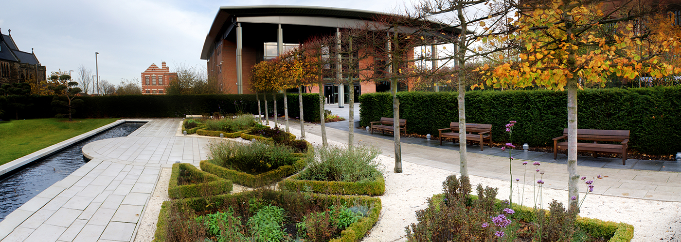
LHU Music Department now
The music department belongs in the School of Creative and Performing Arts and is based at the Creative Campus on the edge of Liverpool city centre. Music is normally studied as a half of a combined degree (often with Music Production) and we also run a Musical Theatre major. We offer an MA in Music and have a handful of PhD students, and staff specialisms include composition (broadly defined), various aspects of music production, performance across various genres and jazz studies.

Slide 6
Communities of Practice
Definition: “groups of people who share a common concern or passion for something they do and learn how to do it better as they interact regularly” (Wenger-Trayner and Wenger-Trayner, 2015)
Required elements:
  Domain (of interest)
  Community (of people involved)
  Practice (being developed, with a shared repertoire of resources)

Slide 7
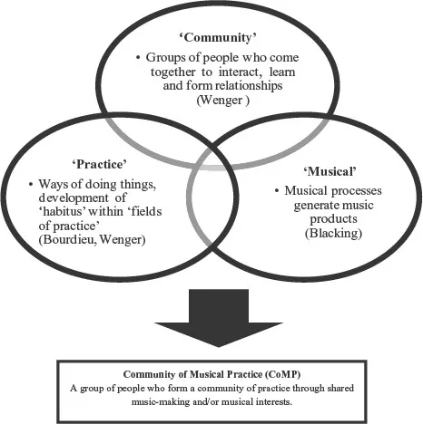

Communities of Musical Practice (CoMP) model (Kenny 2016: 16)

Slide 8
Recent outreach activities
Various types of Music Taster Days on campus with local FE colleges and secondary schools
Taking LHU students to local secondary schools to deliver music workshops
Steinway Piano event on campus with Martin Roscoe involving piano students from local secondary schools (LHU music department is a Steinway School)
Workshops and performances on campus in partnership with Parrjazz involving LHU Big Band and secondary school students (Jazz Camp for Girls and The Feel Good Factor)
Current project: LIJF Youth Collective (again with Parrjazz) including a performance at Liverpool International Jazz Festival, February 2026

Slide 9
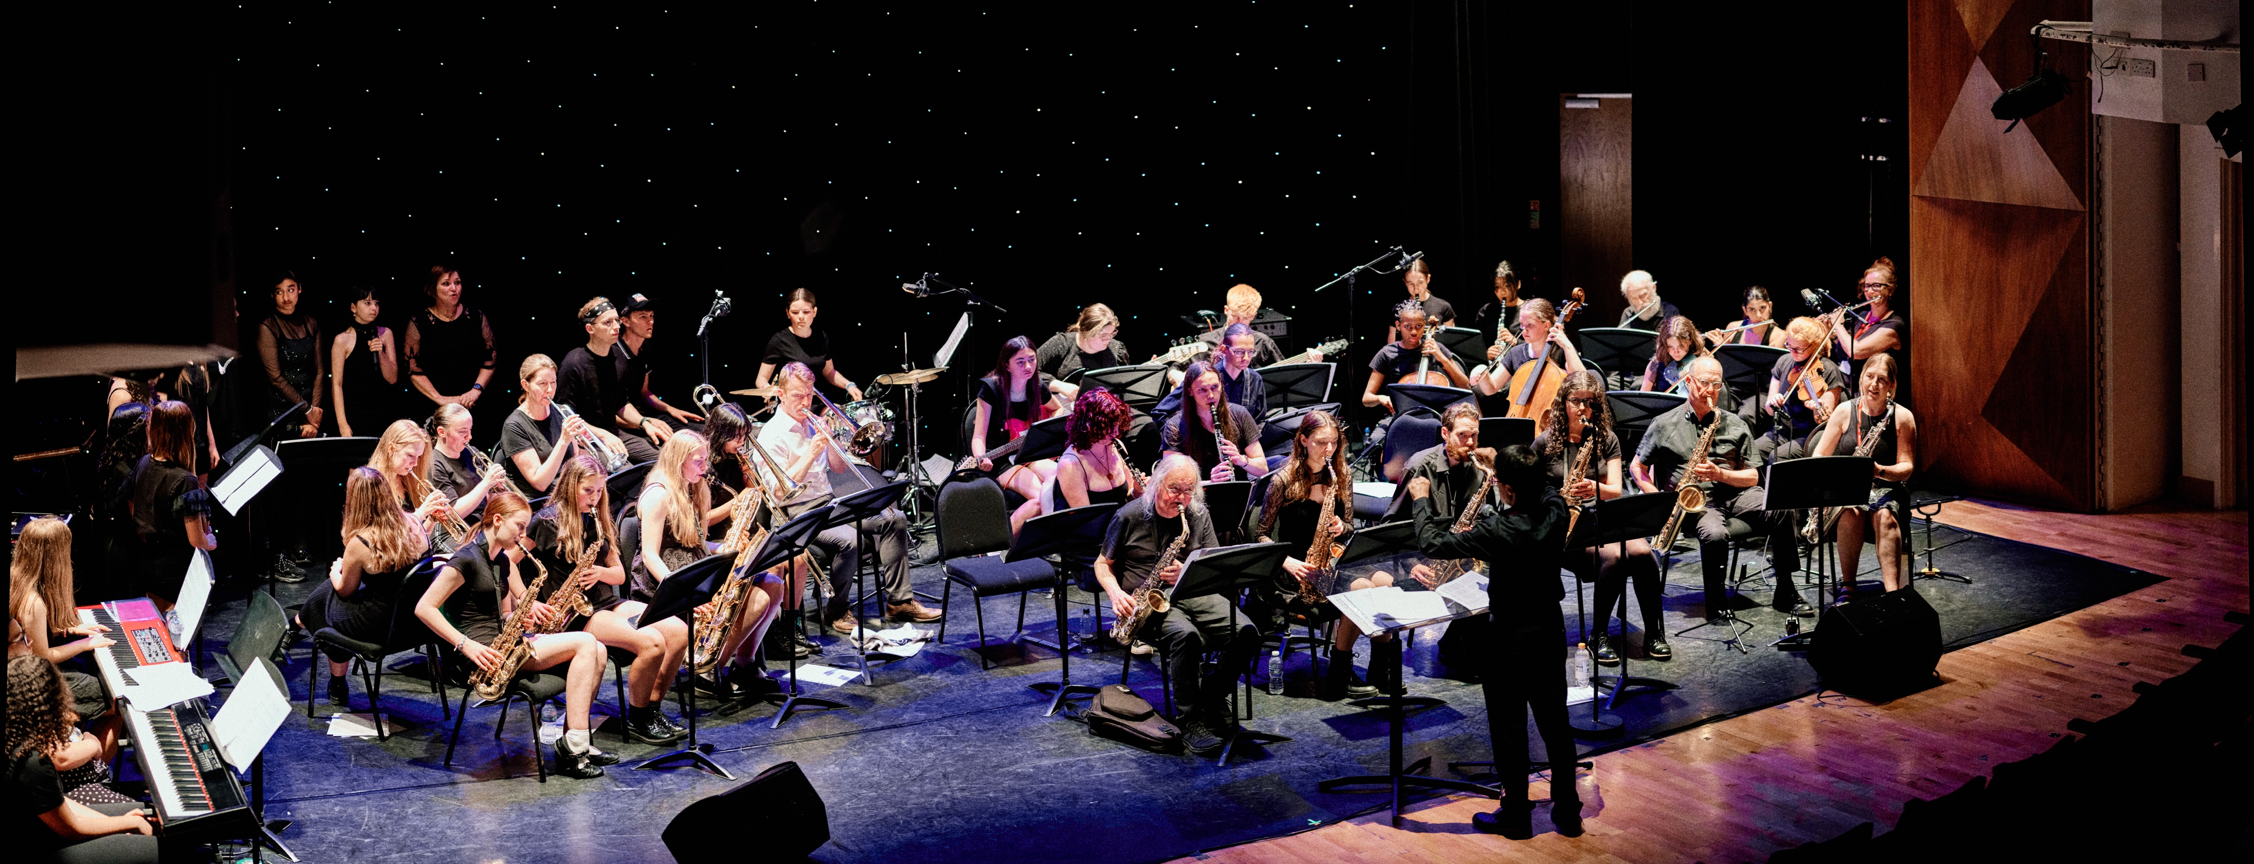
Jazz Camp for Girls

Slide 10
Concluding thoughts
On anecdotal evidence, outreach activities have led to young musicians applying to study music at LHU, or at least considering HE music study, who may not have otherwise done
Bringing prospective students onto campus helps them picture themselves there (feedback from events and open days supports this)
Projects that involve current LHU students and secondary schools such as Jazz Camp for Girls help to build connections and can be considered to form (at least temporarily) a larger Community of Musical Practice
Feedback from the LIJF Youth Collective project will inform the impact of the project (though longitudinal data can be difficult to obtain)
Being a small music department has advantages and disadvantages, but for our cohorts a range of recruitment activities is essential

Slide 11
References
ISM (2025). ‘A-level results: Music entries fall’. https://www.ism.org/news/music-a-level-results-2025/
Kenny, A. (2016). Communities of Musical Practice. Routledge: Abingdon.
Pace, I. (2024). ‘Music in Higher Education 3: Undergraduate Cohorts 2019-2023’. https://ianpace.wordpress.com/2024/10/10/music-in-uk-higher-education-3-undergraduate-cohorts-2019-2023/
Wenger-Trayner, E. & Wenger-Trayner, B. (2015). Introduction to communities of practice: a brief overview of the concept and its uses. https://www.wenger-trayner.com/introduction-to-communities-of-practice/

Slide 12

Thanks for listening – any questions?
sykest@hope.ac.uk

