Slide 1

From Hot Club Swing to StringTing: Learning jazz violin in a community of musical practice
Tom Sykes
Liverpool Hope University

Slide 2
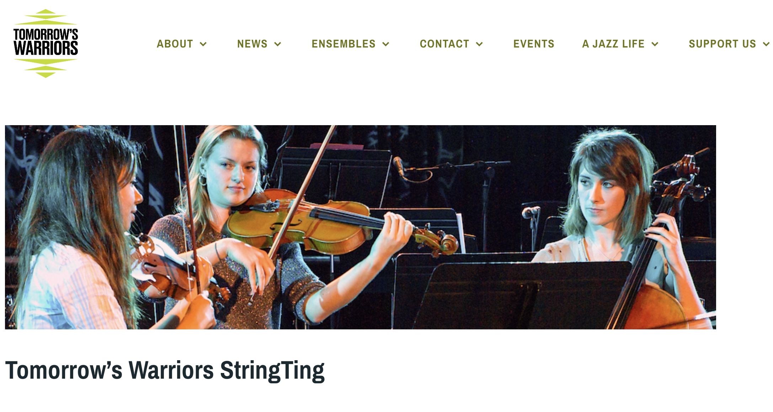

Slide 3
Communities of Practice (Wenger 1998)
These are “groups of people who share a concern or passion for something they do and learn how to do it better as they interact regularly”, comprising 3 elements:
the domain of interest, to which members are committed and which distinguishes them from other people;
the community of people interacting with one another to share knowledge and skills; and
the practice in which the members are engaged in developing a shared repertoire of resources as practitioners.

Slide 4
Communities of Musical Practice (Kenny 2016)
A CoMP is a “group of people who form a community of practice through shared music-making and/or musical interests” with 3 overlapping elements:
“Community” (groups of people coming together to interact, learn, and form relationships);
“Practice” (ways of doing things, or developing “habitus” within “fields of practice” from Bourdieu); and
“Musical” (musical processes that generate music products in Blacking’s conception).

Slide 5
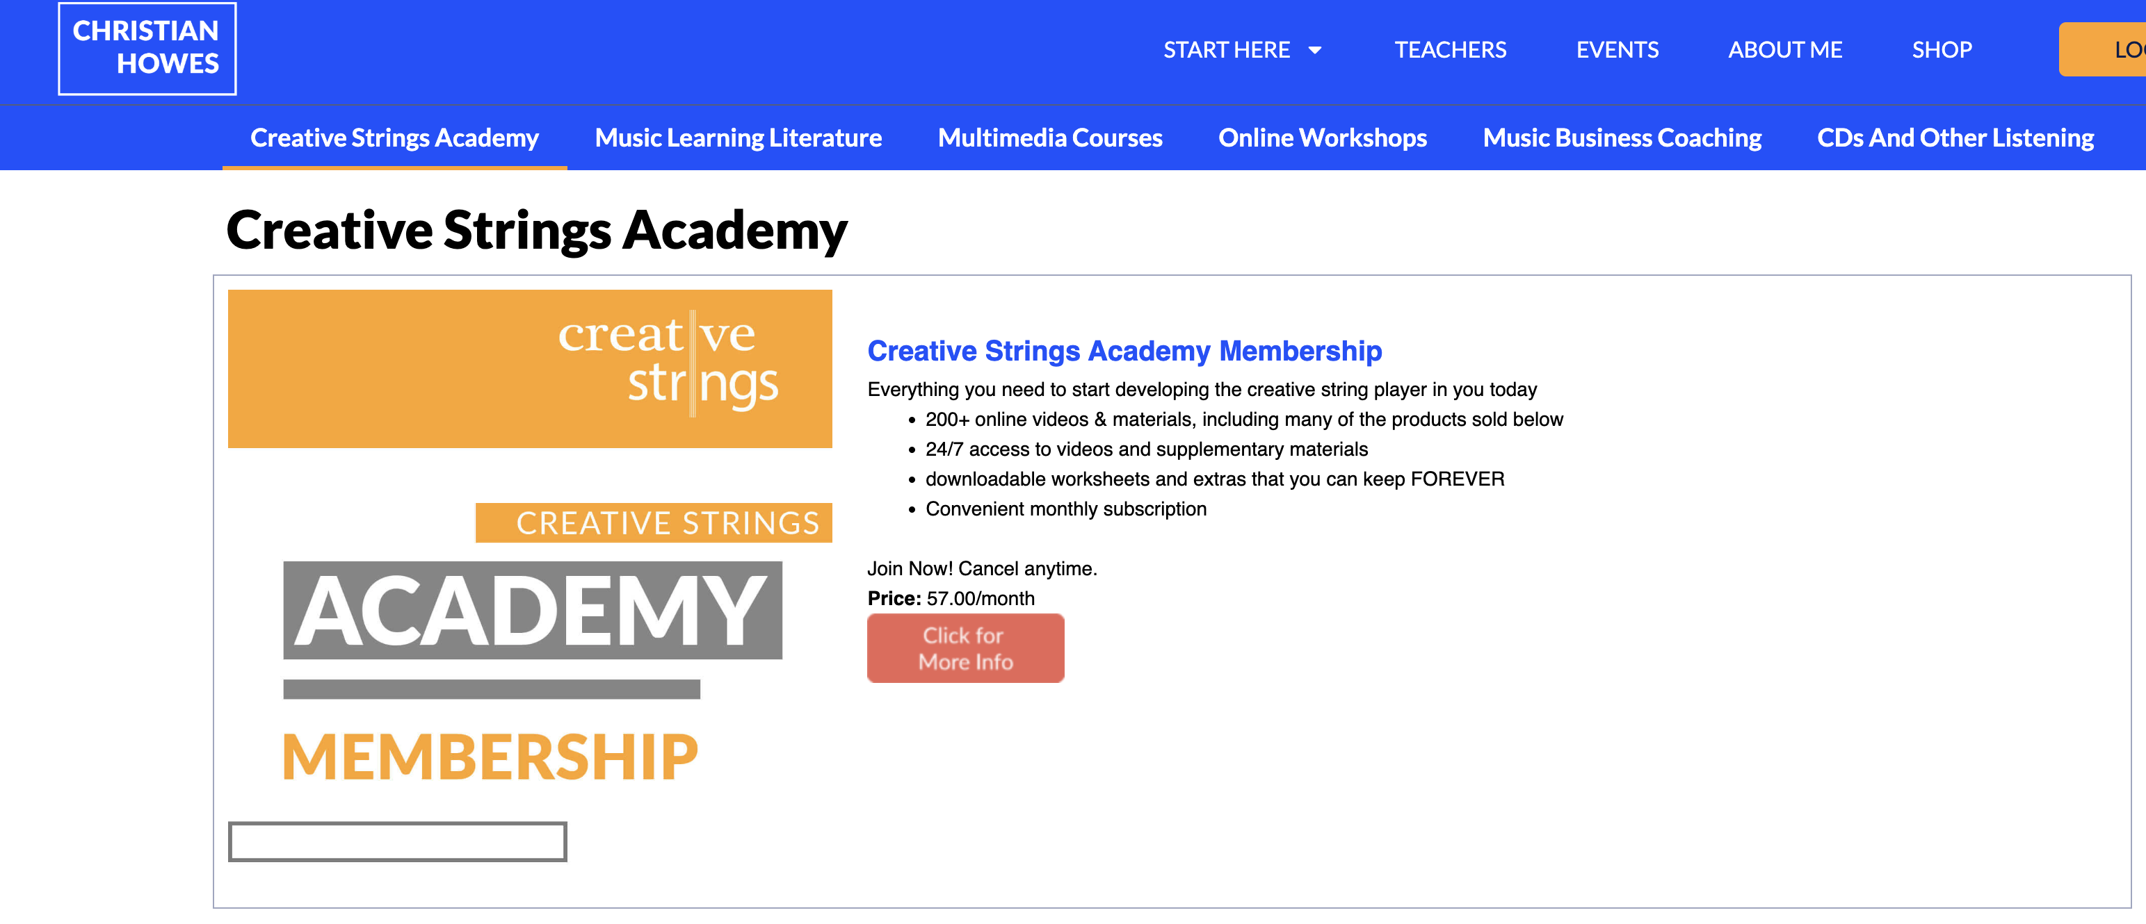
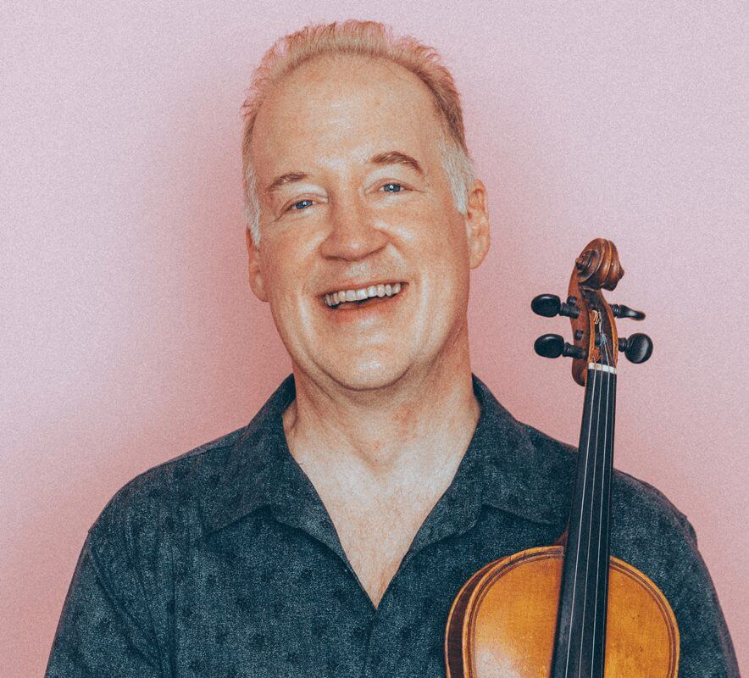
Case Study 1: Creative Strings Academy

Slide 6
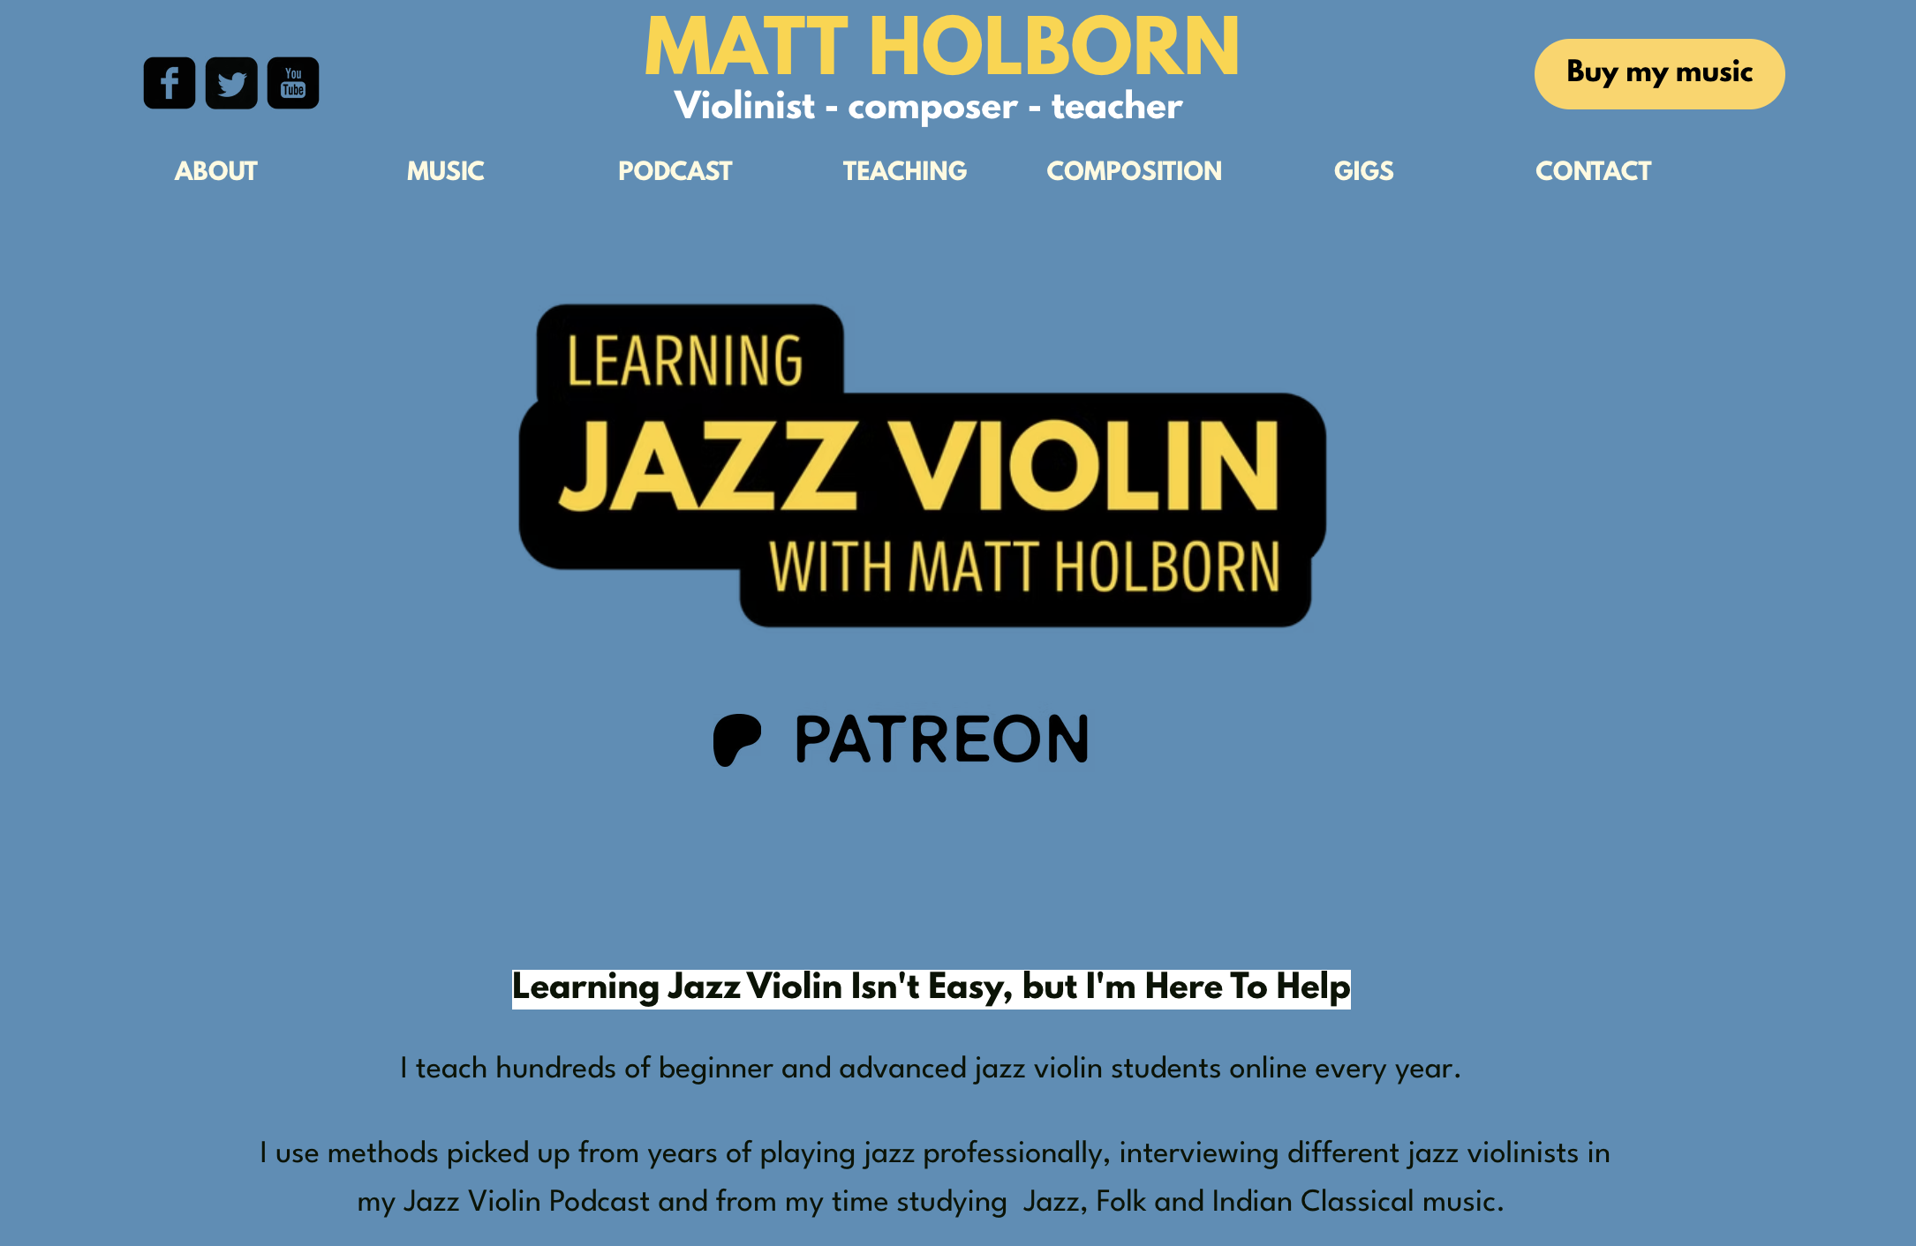
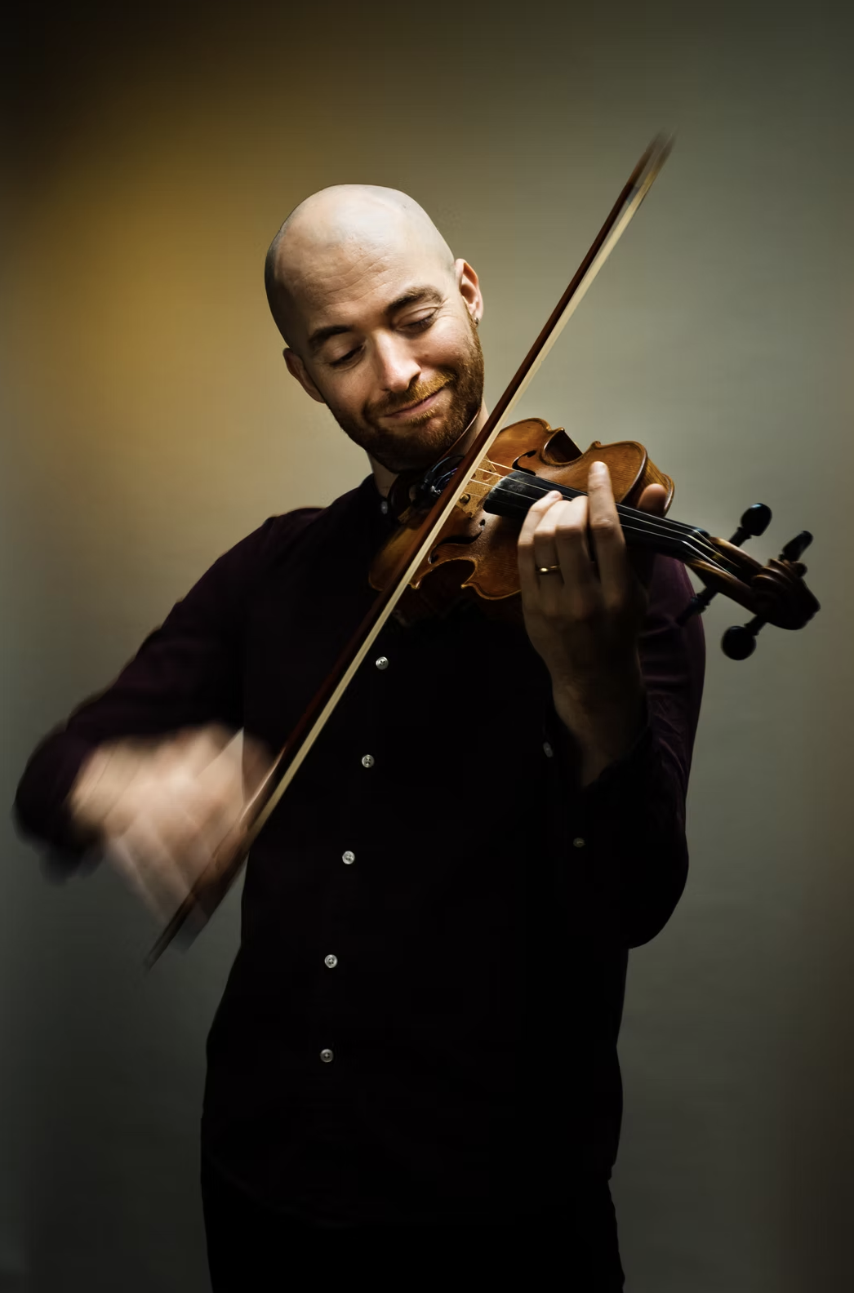
Case Study 2: Learning Jazz Violin

Slide 7
Conclusion: jazz violin and Communities of Musical Practice
Kenny’s case study of an online Community of Musical Practice in Irish traditional music has similarities with Creative Strings Academy and Learning Jazz Violin, particularly in the key elements of community, practice and musical processes.
Creative Strings Academy and Learning Jazz Violin also possess Wenger’s Community of Practice dimensions: mutual engagement (regular online meetings), joint enterprise (to improve members’ practice) and shared repertoire (guided practice sessions; teaching and learning resources).
For a minority interest such as jazz violin, Creative Strings Academy and Learning Jazz Violin are Communities of Musical Practice that provide people who share this interest an opportunity to participate and develop their practice with others.

Slide 8
Sources
Christian Howes 2025. https://christianhowes.com/.
Holborn, M. 2025. Personal interview via video call.
Howes, C. 2025. Personal interview via email.
Kenny, A. 2016. Communities of Musical Practice. Abingdon: Routledge.
Matt Holborn 2025. https://www.mattholborn.com/.
Tomorrow’s Warriors StringTing 2025. https://tomorrowswarriors.org/bands/tw-stringting-jazz-string-ensemble/.
Wenger, E. 1998. Communities of Practice: Learning, Meaning, and Identity. Cambridge: Cambridge University Press.

Slide 9
Thank you for listening!
sykest@hope.ac.uk

